Slide 1
Chapter 11
The Basics of Capital Budgeting
Tan Khim Yang
Tan Tek Wui
Teoh Wei Loon
Khaw Chun Hao
Ooi Yan Ning

Slide 2
Review
Steps to capital budgeting:
Estimate CF
Assess risk of CF
Determine appropriate cost of capital. Based on riskiness of CFs
Find NPV/IRR
Accept if
NPV>0 or IRR>WACC → Independent projects
Highest positive NPV or Highest positive ( IRR-WACC)→ Mutually exclusive projects

Slide 3
Review
Decision criteria:
Net Present Value (NPV)
Internal Rate of Return (IRR) and Modified IRR (MIRR)
(Regular) Payback and Discounted Payback

Slide 4
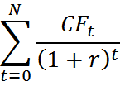




Review Net Present Value
Sum of the PVs of all cash flows of a project
Accept project If NPV >0
Formula:
NPV=
=
+
+…+

Slide 5
Review
Decision criteria:
Net Present Value (NPV)
Internal Rate of Return (IRR) and Modified IRR (MIRR)
(Regular) Payback and Discounted Payback

Slide 6
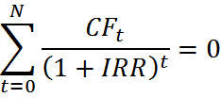
Review Internal Rate of Return
Discount rate that forces PV of cash inflows to equal to PV of costs
IRR of project is conceptually similar to YTM of a bond
If IRR> WACC, accept the project

Slide 7
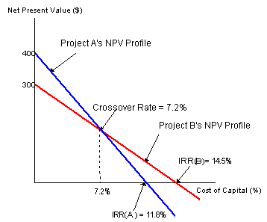
Review NPV Profile
Graphical representation of project NPV at various costs of capital

Slide 8
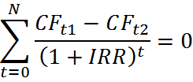
Review
Crossover rate: Value of WACC where the project NPVs are equal
If projects are independent, both NPV method and IRR method leads to same decision
If projects are mutually exclusive,
If WACC>crossover rate-> same decision
If WACC<crossover rate->different decision as NPV(A) is higher, but has lower IRR
Calculation of crossover rate: Use difference in cash flow of two projects, find IRR

Slide 9
Review Multiple IRR
Normal cash flow-Negative cash flows followed by positive cash flow. One change of sign
Non-normal cash flow- two more changes of sign
Non-normal cash flow can lead to multiple solutions of IRR

Slide 10
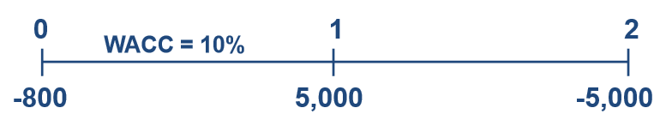
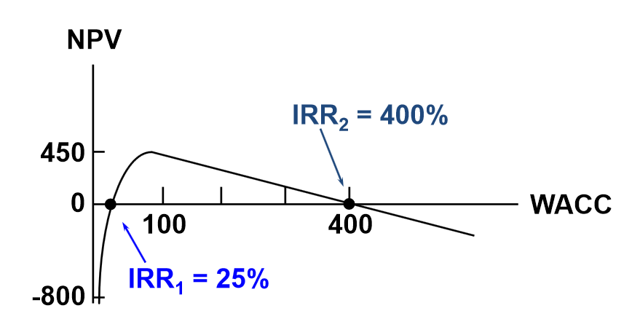
Review Multiple IRR

Slide 11
Review Modified IRR
Alternative to IRR
The discount rate that causes PV of a project’s Terminal Value(TV) to equal PV of costs
MIRR assumes re-investment of cash flows at WACC
Avoids problem of multiple IRR

Slide 12

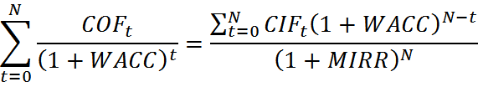
Review Modified IRR
Formula:

Slide 13
Review
Decision criteria:
Net Present Value (NPV)
Internal Rate of Return (IRR) and Modified IRR (MIRR)
(Regular) Payback and Discounted Payback

Slide 14
Review Payback Period
The number of years to recover a project’s costs
Calculating by adding cash inflows until cumulative CF =0
Payback = No. of years prior to full recovery+ ( unrecovered cost at start of year / Cash flow during full recovery year )
Ignores the time value of money
Discounted payback = Payback taking into account the time value of money( using discounted cash flow )

Slide 15
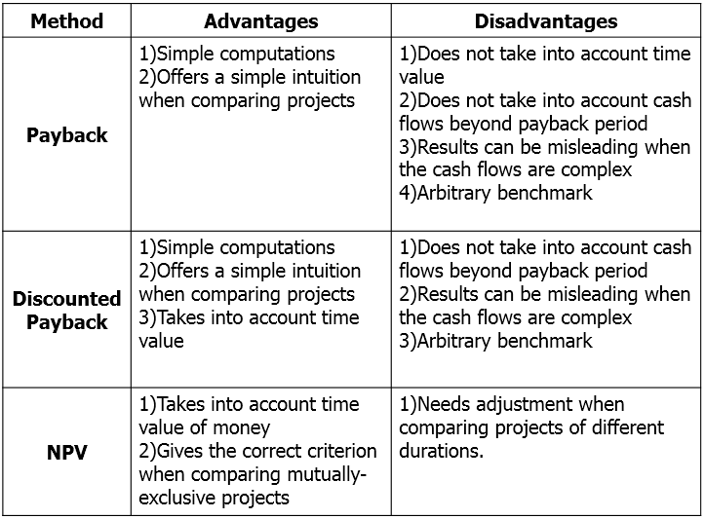
Review Advantages and disadvantages

Slide 16
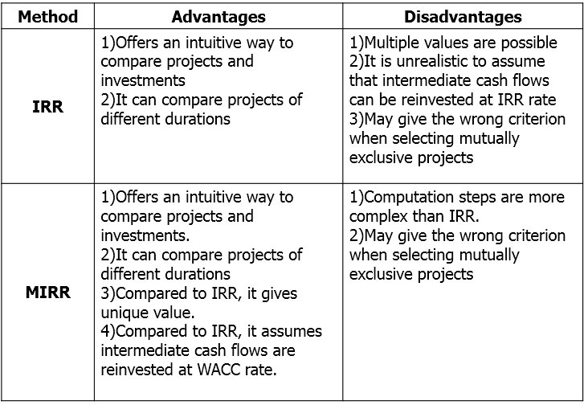
Review Advantages and disadvantages

Slide 17
Review Projects with unequal lives
If projects have unequal life, and are repeatable, we use:
Replacement chain method
Equivalent Annual Annuity (EAA)

Slide 18
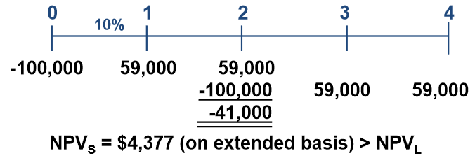
Review Replacement chain
Extending the two projects to a common lifetime and calculating their NPVs

Slide 19
Review Equivalent Annual Annuity
Treating the projects as annuities and calculate the annuity(payment) for each project
Use formula for annuities in chapter 2

Slide 20
Tutorial 8

Slide 21
P12-14 Choosing mandatory projects on the basis of least cost. K. Kim Inc. must install a new air conditioning unit in its main plant. Kim absolutely must install one or the other of the units because otherwise the highly profitable plant would have to shut down. Two units are available, HCC and LCC (for high and low capital costs respectively). HCC has a high capital cost but relatively low operating costs, while LCC has a low capital cost but higher operating costs because it uses more electivity. The units’ costs are shown below. Kim’s WACC is 7 percent.

Slide 22
 | EXPECTED NET CASH FLOWS
YEAR | HCC | LCC
0 | -$600,000 | -$100,000
1 | -$50,000 | -$175,000
2 | -$50,000 | -$175,000
3 | -$50,000 | -$175,000
4 | -$50,000 | -$175,000
5 | -$50,000 | -$175,000

Slide 23
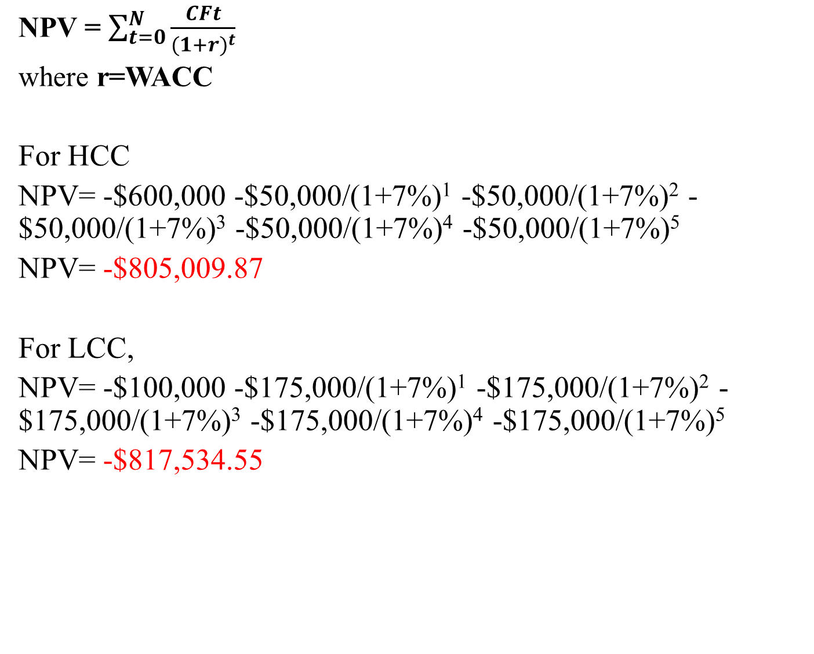
P12-14 a.) Which unit would you recommend? Explain.
NPV = $\sum_{t=0}^{N}{\frac{CFt}{{(1+r)}^{t}}}$
where r=WACC
For HCC
NPV= -$600,000 -$50,000/(1+7%)¹ -$50,000/(1+7%)² -$50,000/(1+7%)³ -$50,000/(1+7%)⁴ -$50,000/(1+7%)⁵
NPV= -$805,009.87
For LCC,
NPV= -$100,000 -$175,000/(1+7%)¹ -$175,000/(1+7%)² -$175,000/(1+7%)³ -$175,000/(1+7%)⁴ -$175,000/(1+7%)⁵
NPV= -$817,534.55

Slide 24
a)
Calculator method:
For HCC
CF0 = -$600,000, CF1-5 = -$50,000, I/YR = 7
, solve for NPV = -$805,009.87
For LCC
CF0 = -$100,000 CF1-5 = $-175,000, I/YR = 7,
solve for NPV = -$817,534.55

Slide 25
P12-14 a.) -Since both HCC and LCC have negative NPV, it means that the installation of the air conditioning unit for both HCC and LCC incur loss (costs). NPV(HCC) > NPV(LCC) -Hence, choose the installation of HCC which incur less cost (less negative NPV) since installation must still be done to maintain the highly profitable plant.

Slide 26
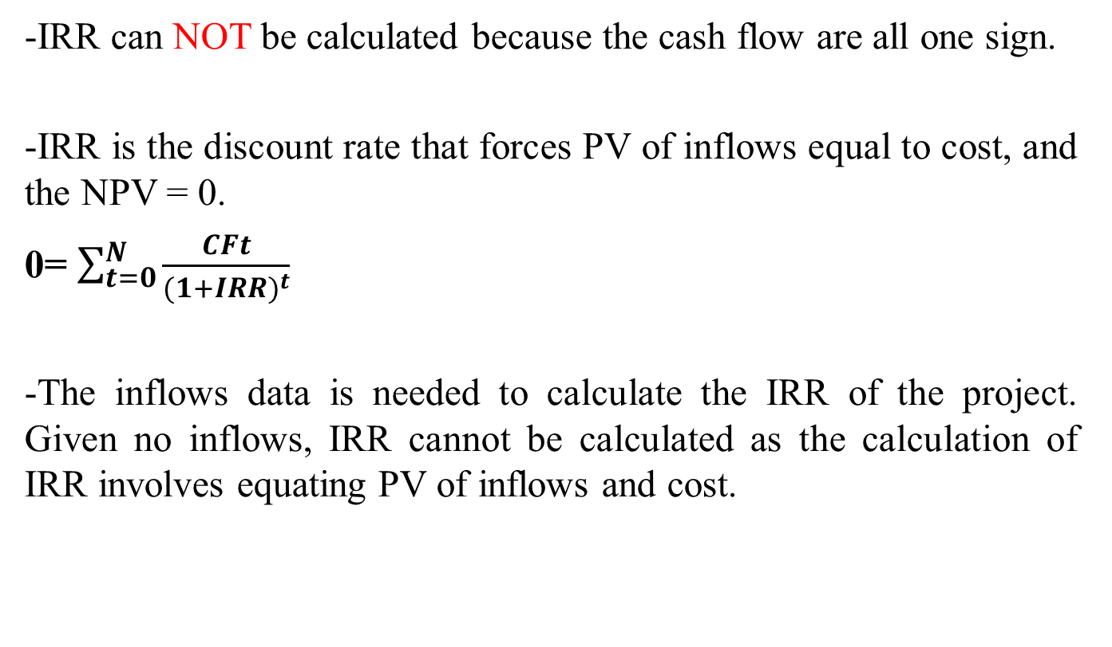
P12-14 b.)If Kim’s controller wanted to know the IRRs of the two projects, what would you tell him?
-IRR can NOT be calculated because the cash flow are all one sign.
-IRR is the discount rate that forces PV of inflows equal to cost, and the NPV = 0.
0= $\sum_{t=0}^{N}{\frac{CFt}{{(1+IRR)}^{t}}}$
-The inflows data is needed to calculate the IRR of the project. Given no inflows, IRR cannot be calculated as the calculation of IRR involves equating PV of inflows and cost.

Slide 27
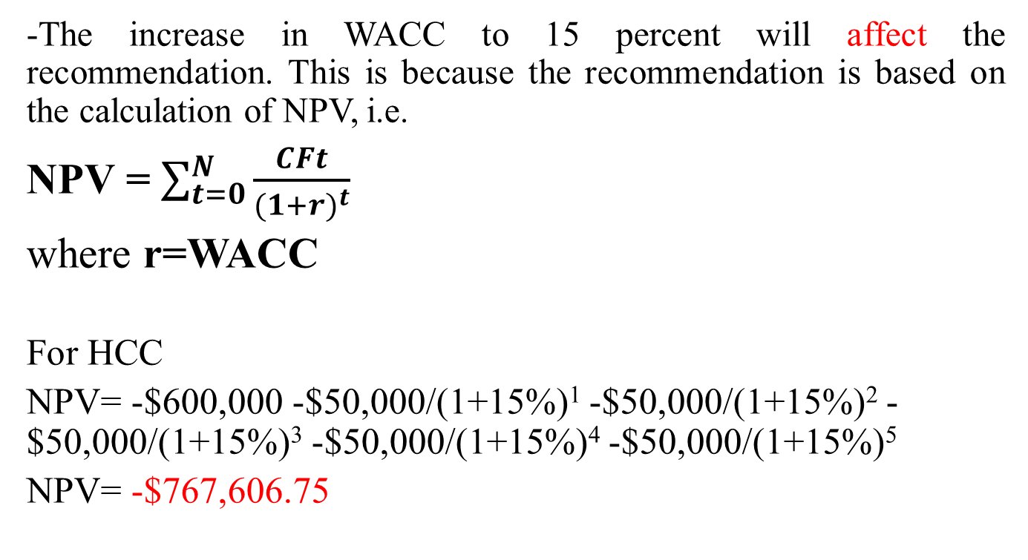
P12-14 c.) If the WACC rose to 15 percent, would this affect your recommendation? Explain your answer and why this result occurred.
-The increase in WACC to 15 percent will affect the recommendation. This is because the recommendation is based on the calculation of NPV, i.e.
NPV = $\sum_{t=0}^{N}{\frac{CFt}{{(1+r)}^{t}}}$
where r=WACC
For HCC
NPV= -$600,000 -$50,000/(1+15%)¹ -$50,000/(1+15%)² -$50,000/(1+15%)³ -$50,000/(1+15%)⁴ -$50,000/(1+15%)⁵
NPV= -$767,606.75

Slide 28
P12-14
C)
For LCC,
NPV= -$100,000 -$175,000/(1+15%)¹ -$175,000/(1+15%)² -$175,000/(1+15%)³ -$175,000/(1+15%)⁴ -$175,000/(1+15%)⁵
NPV= -$686,627.14
NPV(LCC) > NPV(HCC)
-LCC should be chosen.
-Hence, an increase in WACC means that there is a higher discount rate of NPV. This will change the value of NPV for HCC and LCC and therefore affects the recommendation.

Slide 29
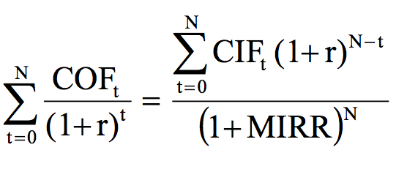

P 12-17 Calculated MIRR of project A
Formula used:
$$PV of Outflow=\frac{FV of inflow}{\left(1+MIRR\right)N}$$

Slide 30
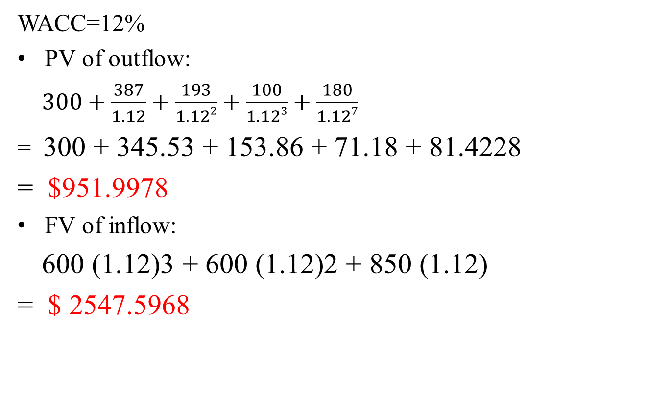
P 12-17
WACC=12%
PV of outflow:
$300+\frac{387}{1.12}+\frac{193}{1.122}+\frac{100}{1.123}+\frac{180}{1.127}$
= 300 + 345.53 + 153.86 + 71.18 + 81.4228
= $951.9978
FV of inflow:
600 (1.12)3 + 600 (1.12)2 + 850 (1.12)
= $ 2547.5968

Slide 31

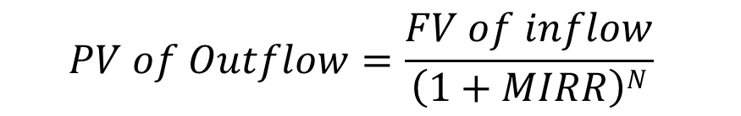

P 12-17
Using financial calculator,
N=7, PV= -952, PMT=0, FV=2,547.60 , Solve for I/YR = MIRR = 15.10%
$$PV of Outflow=\frac{FV of inflow}{\left(1+MIRR\right)N}$$
$$951.9978=\frac{2547.59}{\left(1+MIRR\right)7}$$
$MIRR=$ 15.10 %

Slide 32
P12-18
NPV and IRR. A store has 5 years remaining on its lease in a mall. Rent is $2,000 per month, 60 payments remain, and the next payment is due in 1 month. The mall’s owner plans to sell the property in a year and wants rent at that time to be high so the property will appear more valuable. Therefore, the store has been offered a “great deal” (owner’s words) on a new 5-year lease. The new lease calls for no rent for 9 months, then payments of $2,600 per month for the next 51 months. The lease cannot be broken, and the store’s WACC is 12 percent (or 1 percent per month).

Slide 33
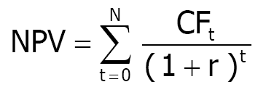
P 12-18
a) Should the new lease be accepted? (Hint: Be sure to use 1 percent per month.)
0
1
2
9
10
59
60
0
0
-2,000
1
-2,000
2
-2,000
9
-2,000
10
-2,000
59
-2,000
60
0
0
0
0
-2,600
-2,600
-2,600

Slide 34
Calculator method:
Old lease: CF0 = 0, CF1-60 = -2,000, I/YR = 1
, solve for NPV = -89,910.08
New lease: CF0 = 0, CF1-9 = 0,
CF10-60 = -2,600, I/YR = 1,
solve for NPV = -94,611.45
Therefore, for the storeowner, the new lease should be rejected because the PV outflow for the storeowner is bigger in the new lease than that of old lease.

Slide 35
P 12-18
b) If the storeowner decided to bargain with the mall’s owner over the new lease payment, what new lease payment would make the storeowner indifferent between the new and the old leases?
PV of old lease should be equal to PV of new lease.
0
1
2
9
10
59
60
0
0
0
0
-2,470.80
-2,470.80
-2,470.80
PV of old lease = PV of new lease after bargaining
60
PMT
-89,910.08 =
∑
t
_{t =10} (1.01)
51
∑
PMT
-89,910.08(1.01)⁹ = -98,333.33 =
t
t =1
(1.01)
Using financial calculator, set PV = 98,333.33, N = 51, I/YR = 1, FV = 0, and then solve PMT = -$2,470.80

Slide 36
P 12-18
c) The storeowner is not sure of the 12 percent WACC – it could be
higher or lower. At what nominal WACC would the storeowner be
indifferent between the two leases?
60
∑
t =1
60
∑
t =1
60
PMT_{old}
PMT_{new}
∑ ^{(PMTold − PMTnew )}
=
⇒
= 0
t
t
t
(1 + r)
(1 + r)
(1 + r)
t =1
Period
Old Lease
New lease
∆Lease
0
0
0
0
1-9
-2,000
0
-2,000
10-60
-2,000
-2,600
600
Given CF0 = 0, CF1-9 = -2,000, CF10-60 = 600. By using financial calculator, solve for IRR = 1.9113%, WACC = IRR*12 =
22.94%

Slide 37
P12-23. Capital Budgeting Criteria
Your Division is considering 2 projects. Its WACC is 10%. Table below lists the projects after-tax cash flows (in millions).
Year | Project A ($) | Project B ($)
0 | -30 | -30
1 | 5 | 20
2 | 10 | 10
3 | 15 | 8
4 | 20 | 6

Slide 38

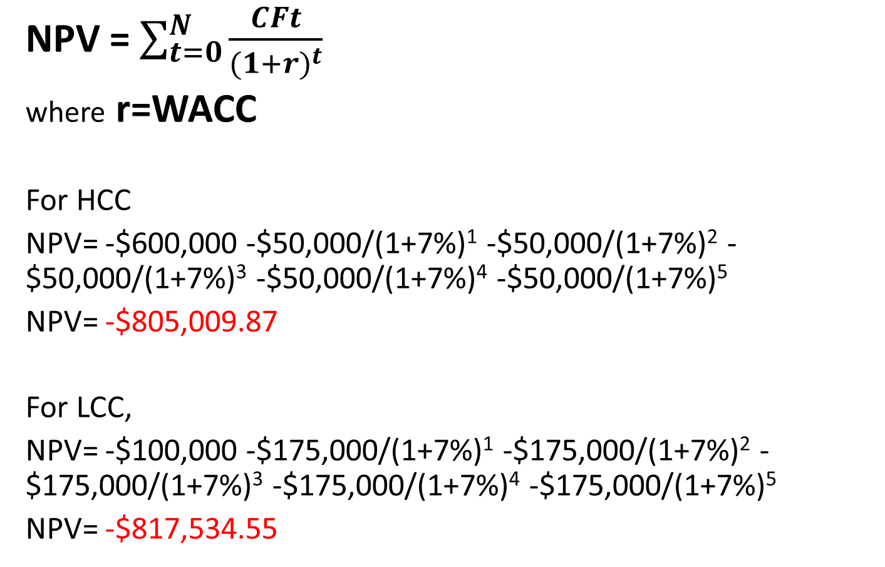
a) Calculate the project’s NPVs, IRRs, MIRRs, Regular Paybacks and Discounted Paybacks
Project A
CF0=-$30 ; CF1= $5 ; CF2=$10 ; CF3=15 ; CF4=20 ;
r= WACC= 10%
NPVA= -30 +$\frac{5}{(1+0.10)}+\frac{10}{{\left(1+0.10\right)}^{2}}+\frac{15}{{\left(1+0.10\right)}^{3}}+\frac{20}{{\left(1+0.10\right)}^{4}}$
=$7.739 million

Slide 39
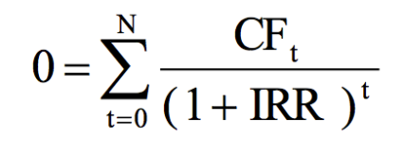
To find IRR:
Financial Calculator method:
Input :CF0=-$30 ; CF1= $5 ; CF2=$10 ; CF3=15 ; CF4=20
Output: IRR = 19.19%

Slide 40
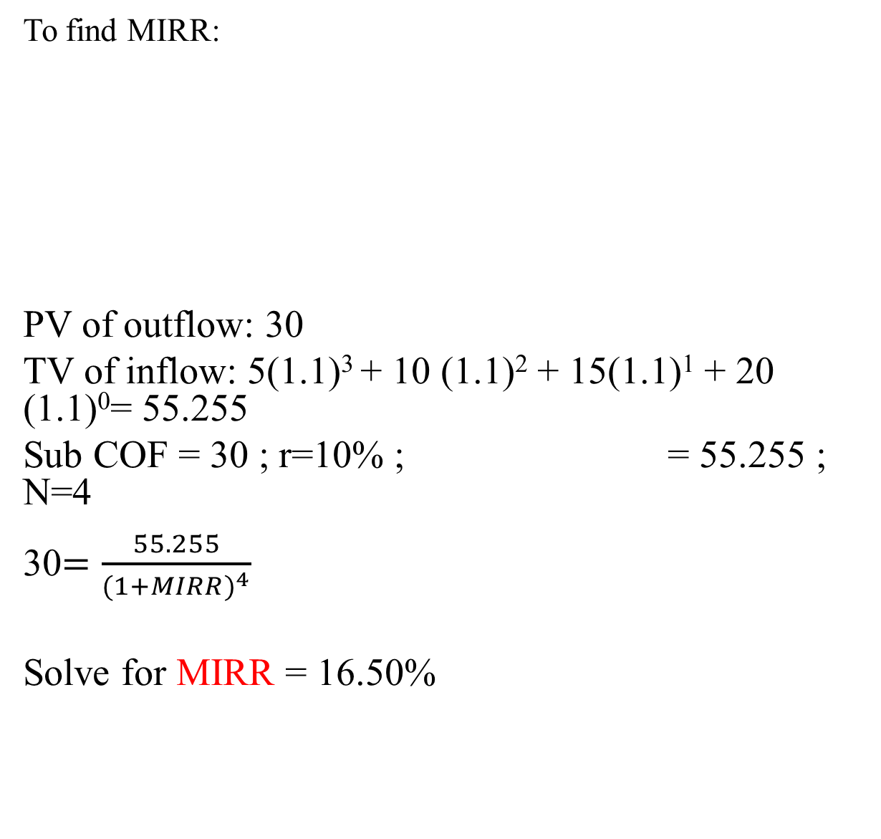
To find MIRR:
PV of outflow: 30
TV of inflow: 5(1.1)³ + 10 (1.1)² + 15(1.1)¹ + 20 (1.1)⁰= 55.255
Sub COF = 30 ; r=10% ; = 55.255 ; N=4
30$=\frac{55.255}{{(1+MIRR)}^{4}}$
Solve for MIRR = 16.50%

Slide 41
Regular Paybacks :
Therefore, PaybackA = 3 years.
 | 0 | 1 | 2 | 3 | 4
CF_{t} | (30) | 5 | 10 | 15 | 20
Cumulative CF_{t} | (30) | (25) | (15) | 0 | 20

Slide 42
Discounted Paybacks :
Project A:
Discounted Payback
= No. of years prior to full recovery + (Unrecovered cost at start of year/Cash flow during full recovery)
=3 + (5.92/13.66)
= 3.43 years
 | 0 | 1 | 2 | 3 | 4
CF_{t} | (30) | 5 | 10 | 15 | 20
PV of CF_{t} | (30) | 4.55 | 8.26 | 11.27 | 13.66
Cumulative CF_{t} | (30) | (25.45) | (17.19) | (5.92) | 20

Slide 43
 | Project A | Project B
NPV | $7.74 mil | $6.55 mil
IRR | 19.19% | 22.52%
MIRR | 16.50% | 15.57%
Regular Payback | 3 years | 2 years
Discounted Payback | 3.43 years | 2.5 years

Slide 44
(b) If the two projects are independent, which project(s) should be chosen?
NPV_{A} = $7.74 mil > 0 ✔
NPV_{B} = $6.55 mil > 0 ✔
Therefore, we should accept both projects because their NPV > 0, both of them are profitable.

Slide 45
(c) If the two projects are mutually exclusive, and WACC = 10%, which project should be chosen?
NPV_{A} > NPV_{B} but IRRB > IRRA > WACC, NPV method assumes CFs are reinvested at the WACC ; IRR method assumes CFs are reinvested at IRR. Assuming CFs are reinvested at WACC is more realistic, so by NPV method, we should choose project A if the two projects are mutually exclusive. Besides, by looking at NPV, we can know the value added to the firm from the project.

Slide 46
(d)Plot NPV profiles for the two projects using WACC of 5, 10, 15, 20 and using the IRR for 2 projects.
WACC (%) | NPV_{A} | NPV_{B}
0 | 20 | 14
5 | 13.24 | 9.96
10 | 7.74 | 6.55
15 | 3.21 | 3.64
19.19 | 0 | 1.52
20 | (0.56) | 1.13
22.52 | (2.23) | 0

Slide 47
NPV profile
IRR_{B} = 22.52%
IRR_{A} = 19.19%

Slide 48
h) Just looking at the Regular and Discounted Paybacks. Which project looks better when judged by the paybacks?
Payback_{A} = 3 years, Discounted Payback_{A} = 3.43 years
Payback_{B} = 2 years, Discounted Payback_{B} = 2.59 years
Project B looks better as the payback is faster, thus liquidity is higher and there is less risk involved. The faster the payback, the more liquid and less risky the project.

Slide 49
P12-19
Multiple IRRs and MIRR. (a), (b), (c) only. A mining company is deciding whether to open a strip mine, which costs $2 million. Net cash inflows of $13 million would occur at the end of Year 1. The land must be returned to its natural state at a cost of $12 million, payable at the end of Year 2. a. Plot the project’s NPV profile using WACC of 0, 10, 50, 80, 100, 200, 300, 400, 410, 420, 430, and 450 (%). b. Should the project be accepted if WACC = 10%? If WACC = 20%? Explain your reasoning. c. Can you think of some other capital budgeting situation in which negative cash flows during or at the end of the project’s life might lead to multiple IRRs?

Slide 50
P12-19
Important points from the question:
Open require $2million ie. Net cash flow = -$2 million
Net inflows of $13million at end of year 1
Return land require $12million at end of year 2. ie. Net cash flow = -$12million
Current year
Year 1
Year 2
Net cash flow:
- $2million
$13million
- $12million

Slide 51
a. Plot the project’s NPV profile using WACC of 0,10,50,80,100,200,300,400,410,420,430, and 450 (%).
WACC | 0 | 10 | 50 | 80 | 100 | 200 | 300 | 400 | 410 | 420 | 430 | 450
NPV | -1000000 | -99200 | 1330000 | 1520000 | 1500000 | 1000000 | 500000 | 120000 | 87700 | 56200 | 25600 | -33100

Slide 52

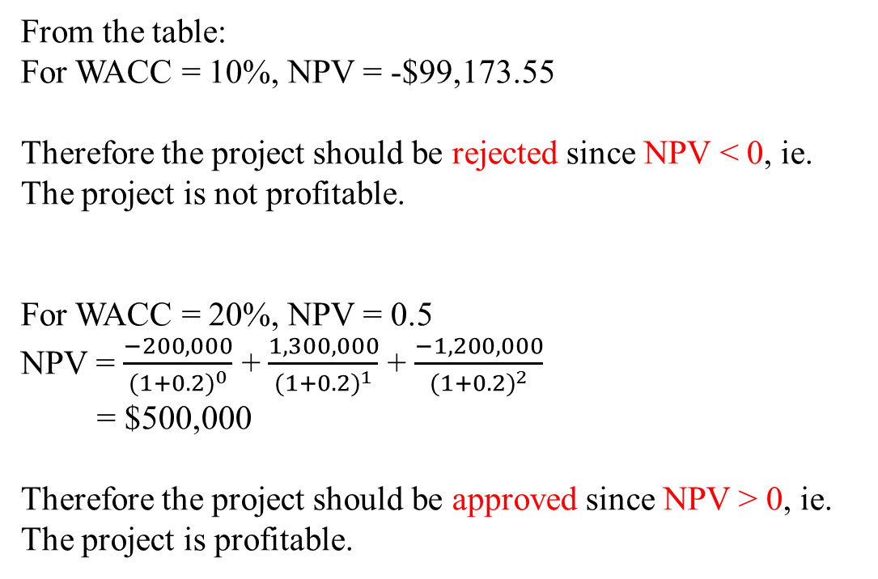
b. Should the project be accepted if WACC = 10%? If WACC = 20%? Explain your reasoning.
NPV = $\sum_{t=0}^{N}{\frac{CFt}{{(1+r)}^{t}}}$
From the table:
For WACC = 10%, NPV = -$99,173.55
Therefore the project should be rejected since NPV < 0, ie. The project is not profitable.
For WACC = 20%, NPV = 0.5
NPV = $\frac{−200,000}{{(1+0.2)}^{0}}$ + $\frac{1,300,000}{{(1+0.2)}^{1}}$ + $\frac{−1,200,000}{{(1+0.2)}^{2}}$
= $500,000
Therefore the project should be approved since NPV > 0, ie. The project is profitable.

